Slide 1
Journey PPT – Week 2 (28/08/23 – 01/09/23)
Megha Sharma
Associate Data Engineer
Emp ID: 654810

Slide 2
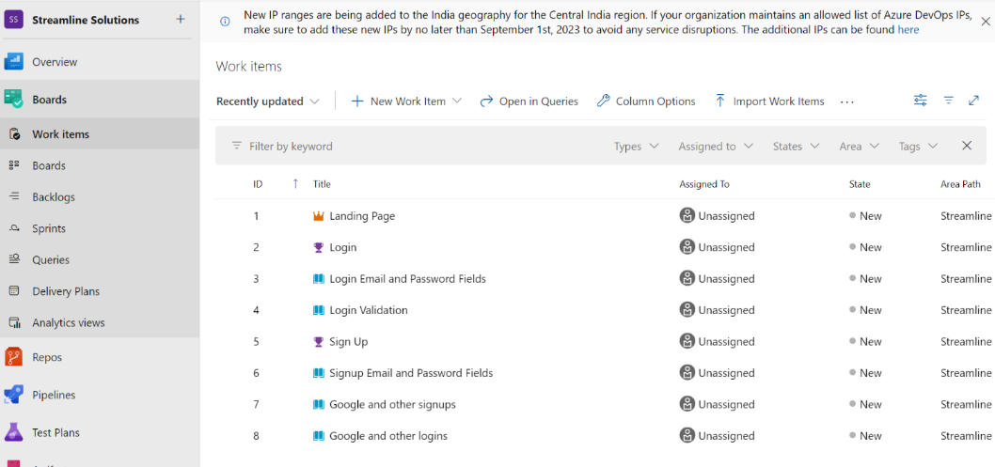
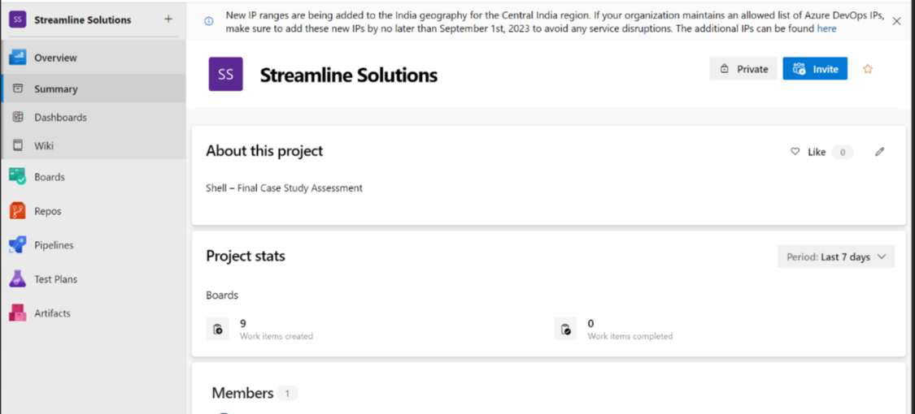
Day 1 (28/08/23)
Worked on the case study:
Azure Board Activities
Project Work Items
Project wiki

Slide 3
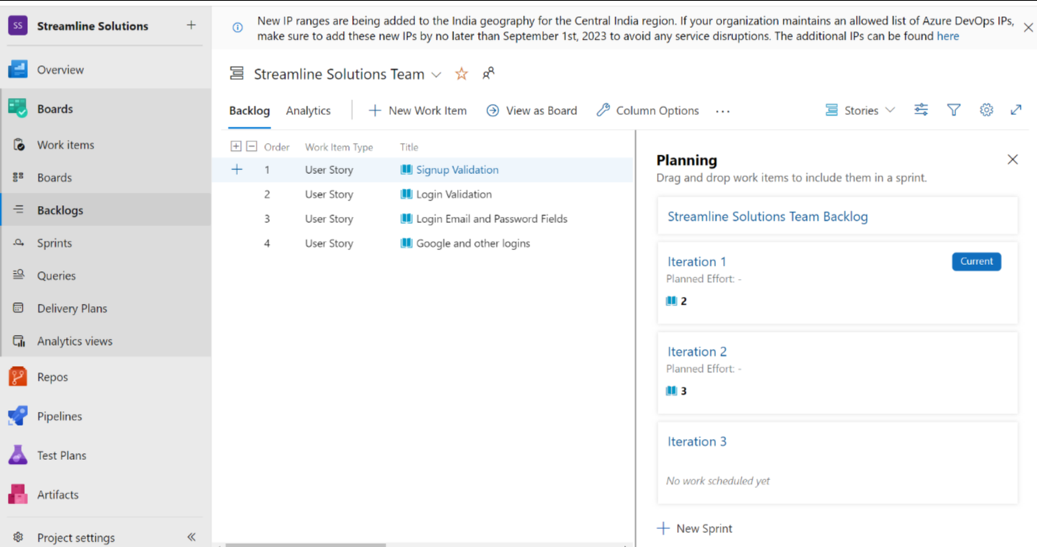
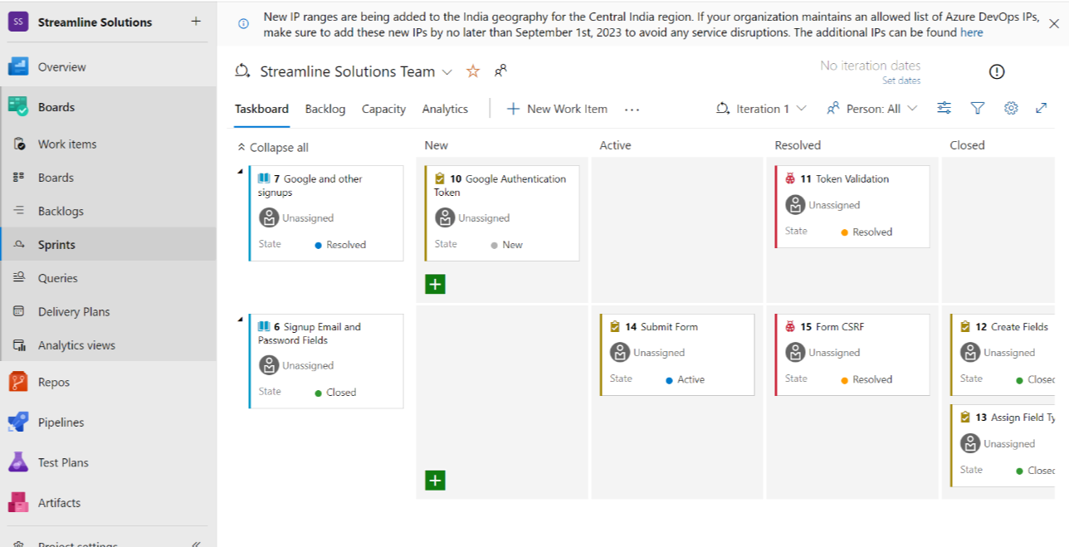
Sprint board
User Story Board

Slide 4
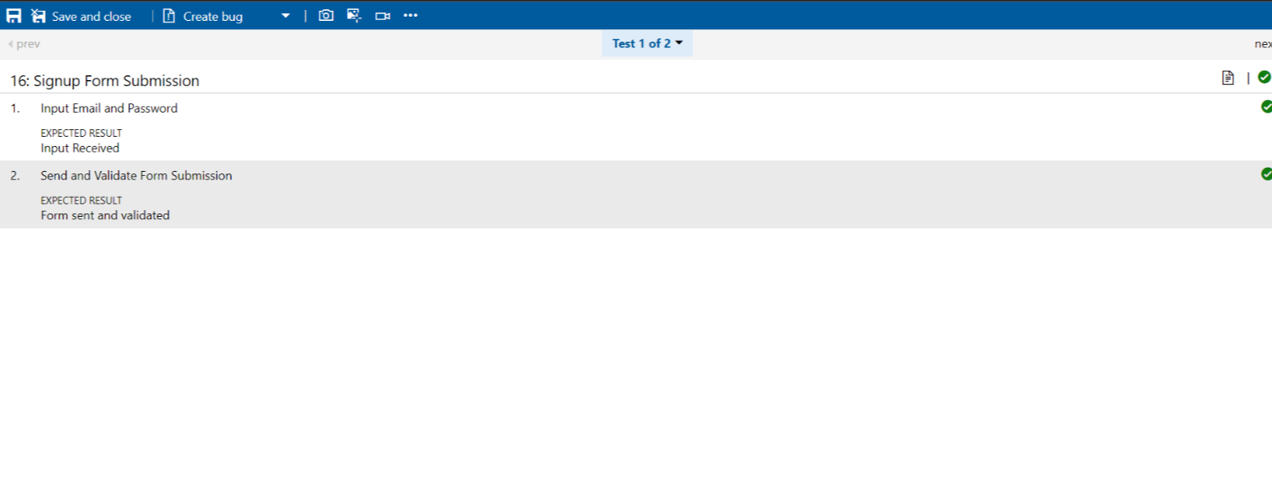
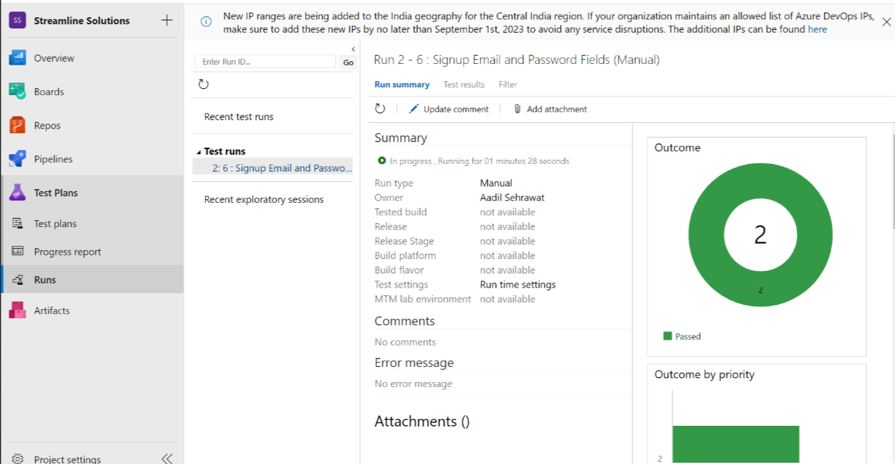
Test cases (passed)
Test runs

Slide 5
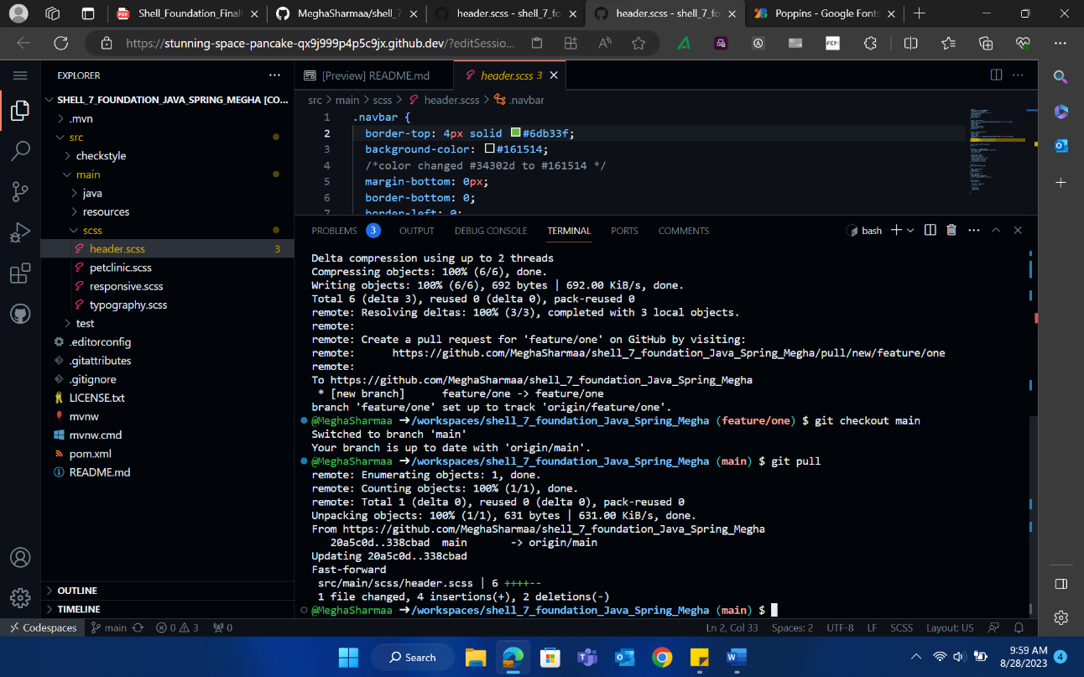
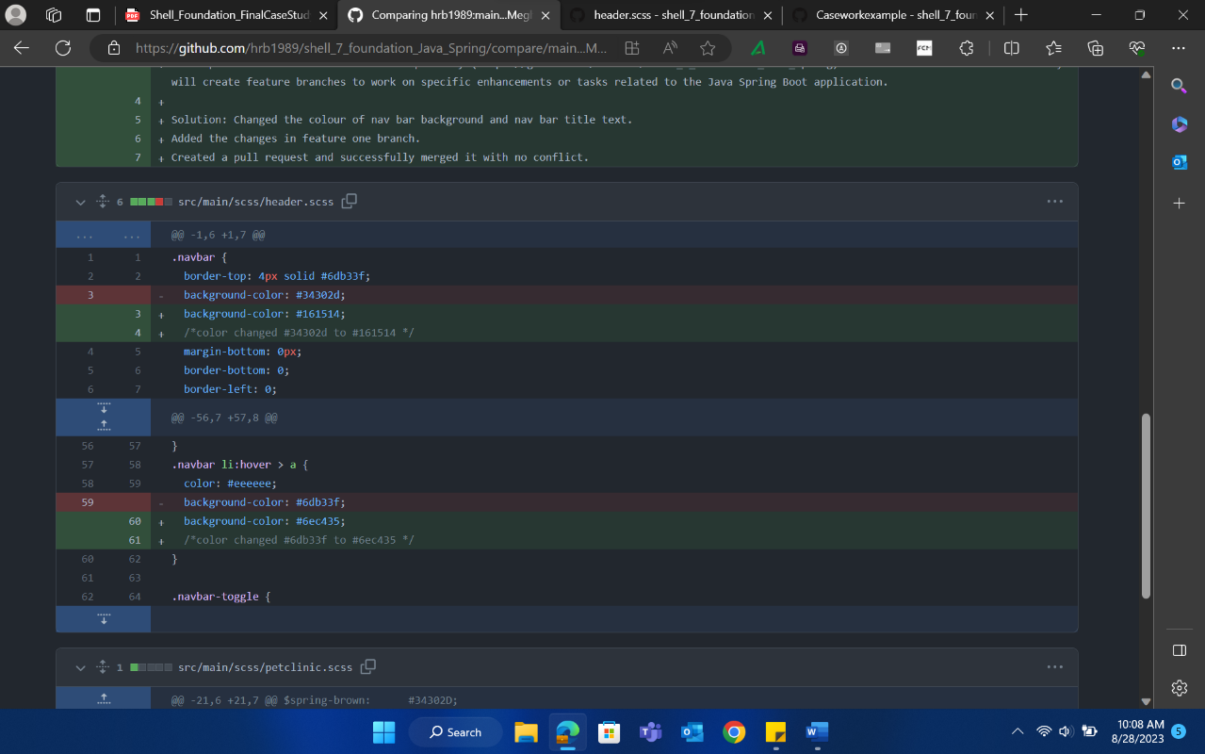
Case study continuation
2. Github Activities
Feature 1 PR Merge
Comparing changes

Slide 6
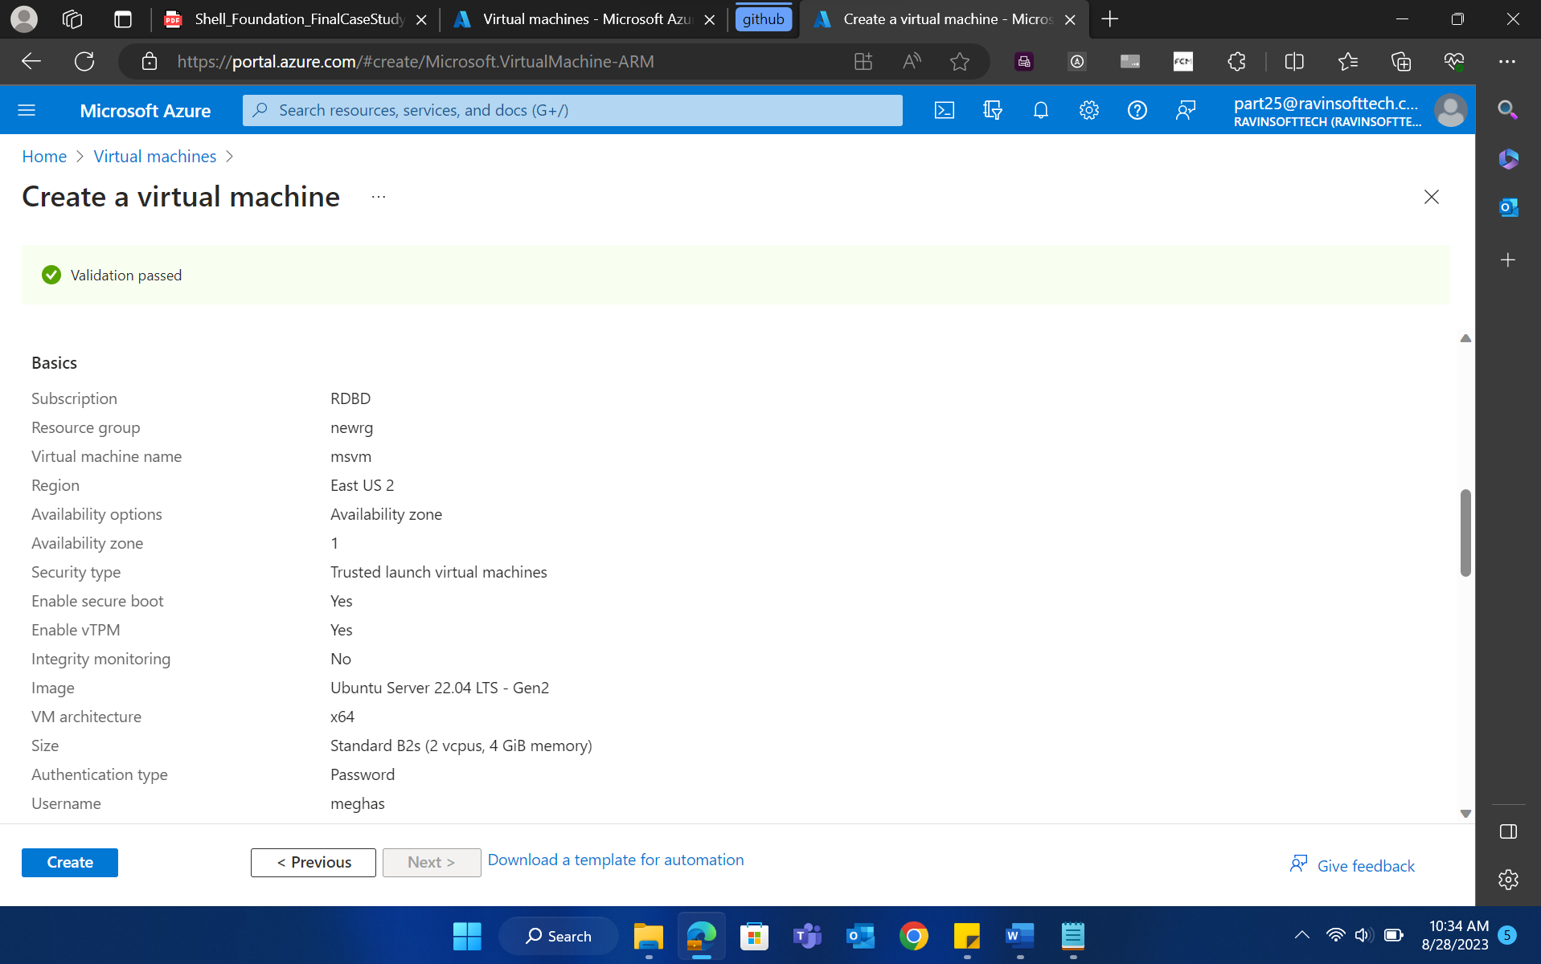
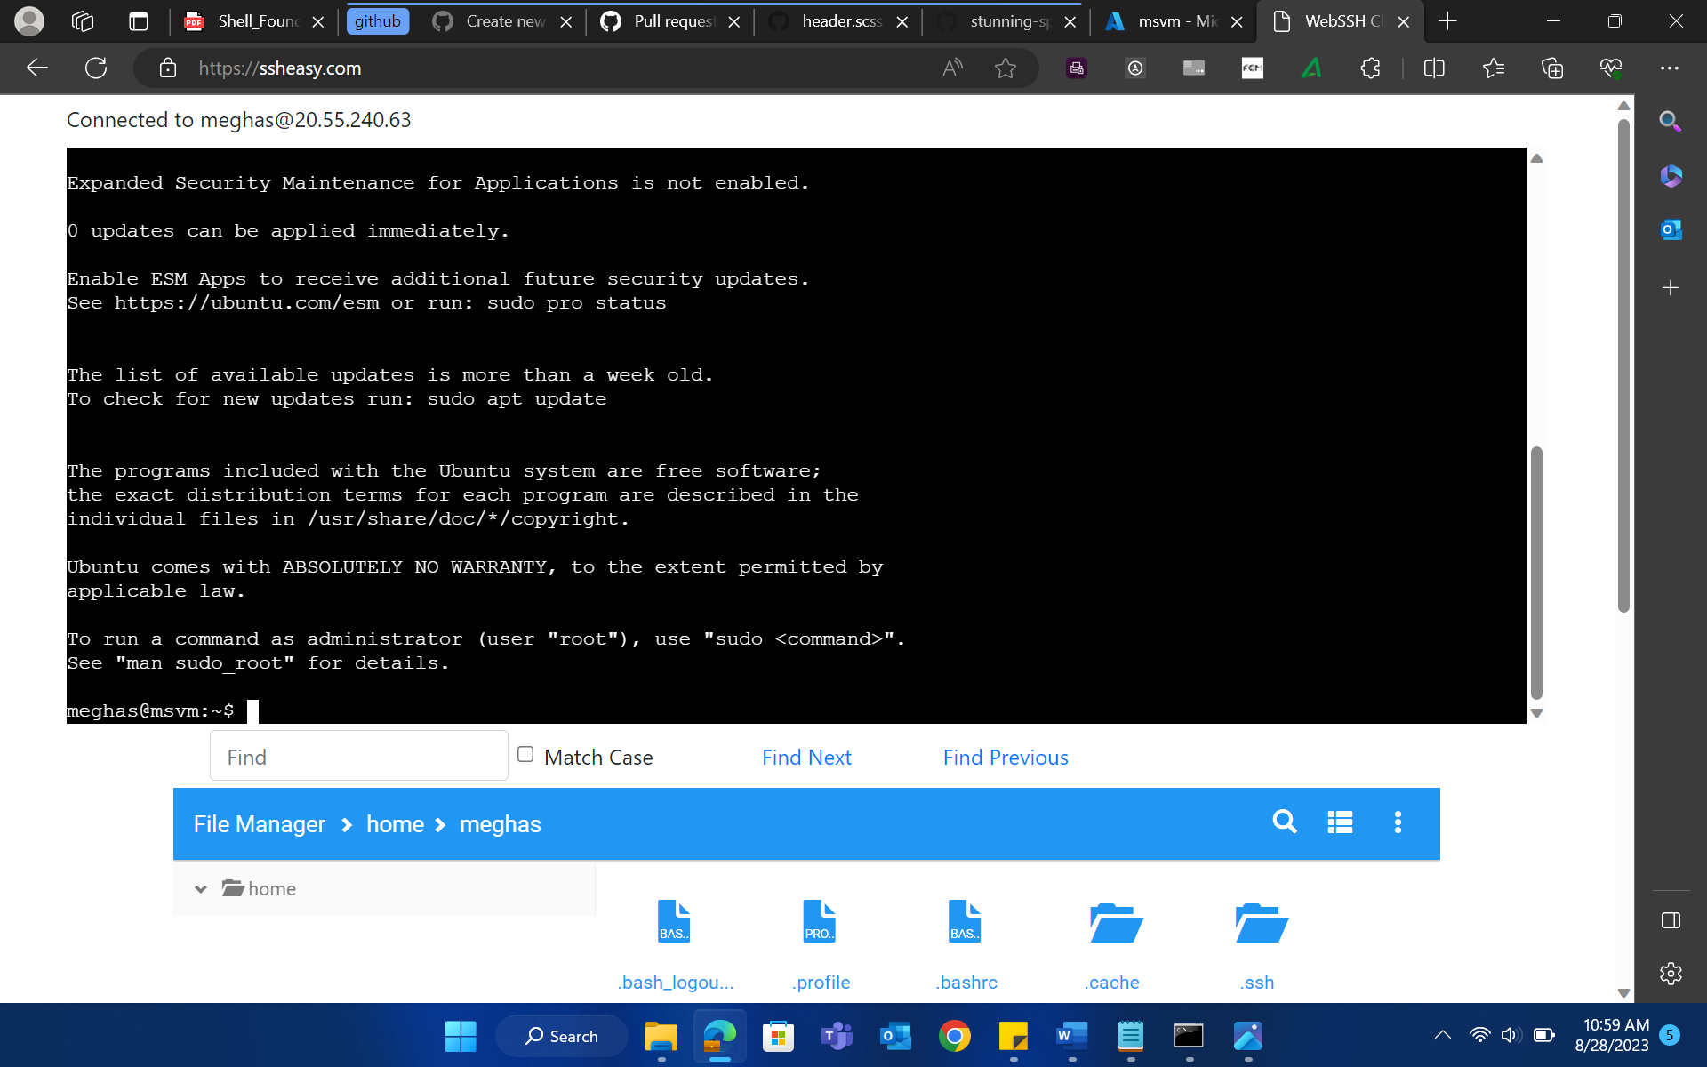
Case study continuation
3. Azure VM Creation
Accessing VM
Creating VM

Slide 7
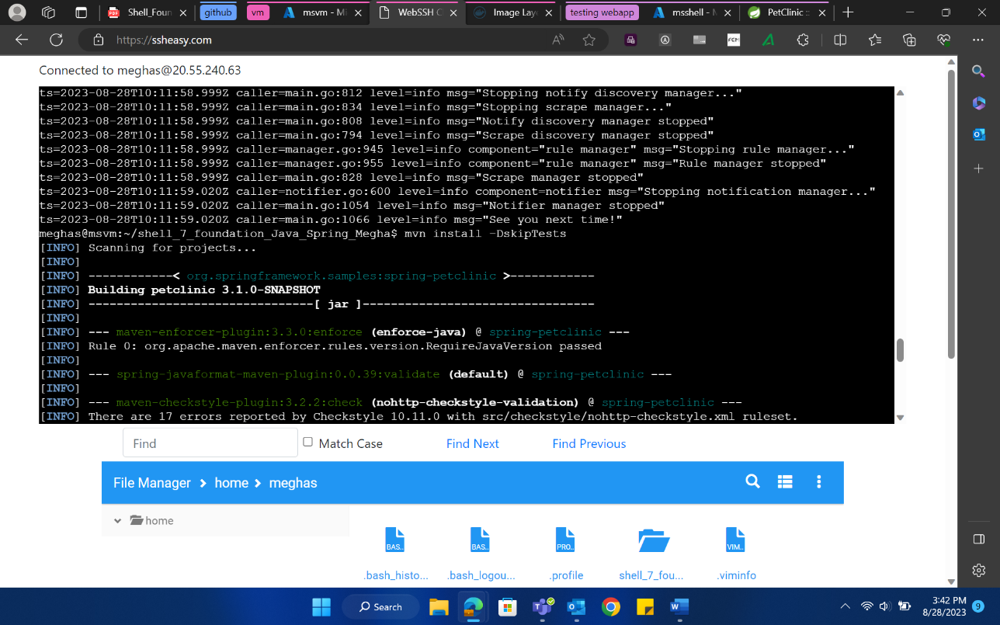
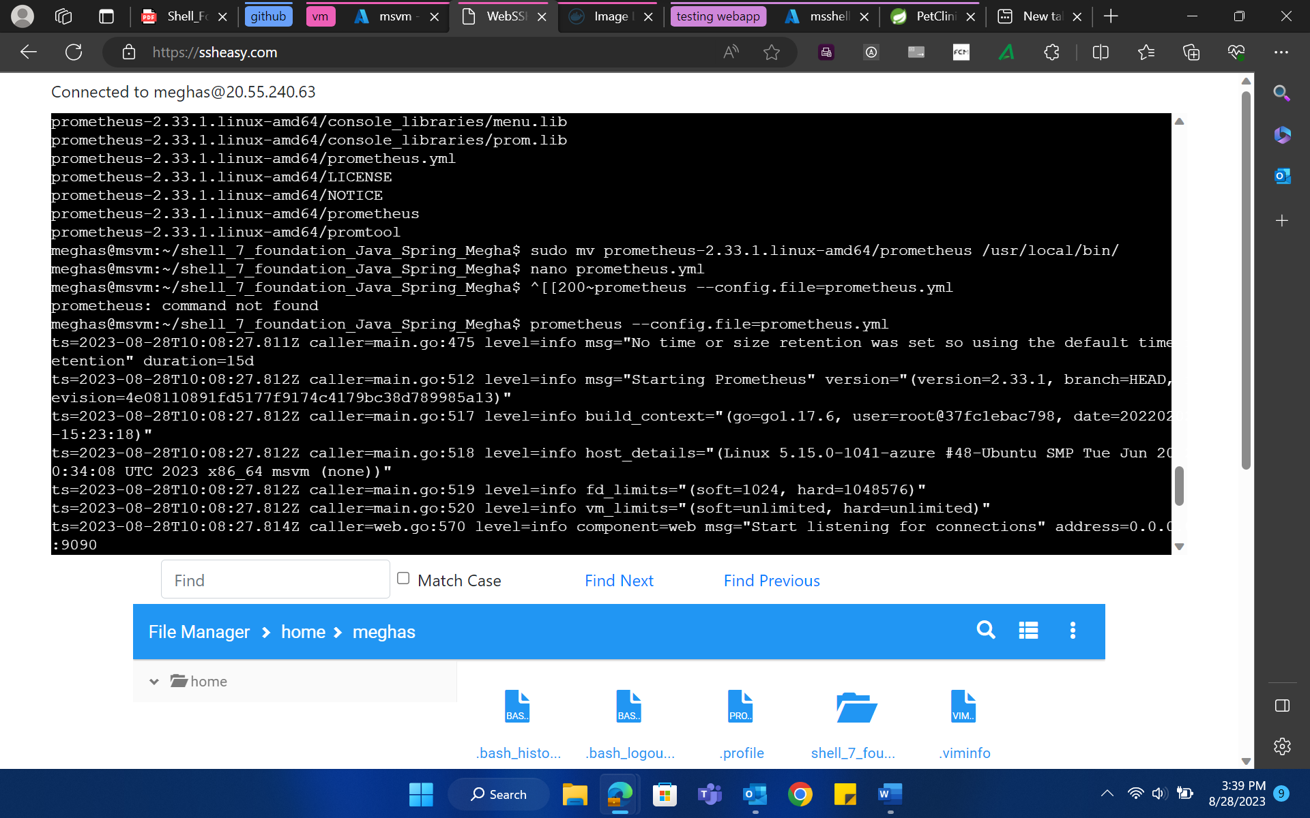
Case study continuation
4. Maven Activity
5. Prometheus Activity
Installing Maven
Installing Prometheus

Slide 8
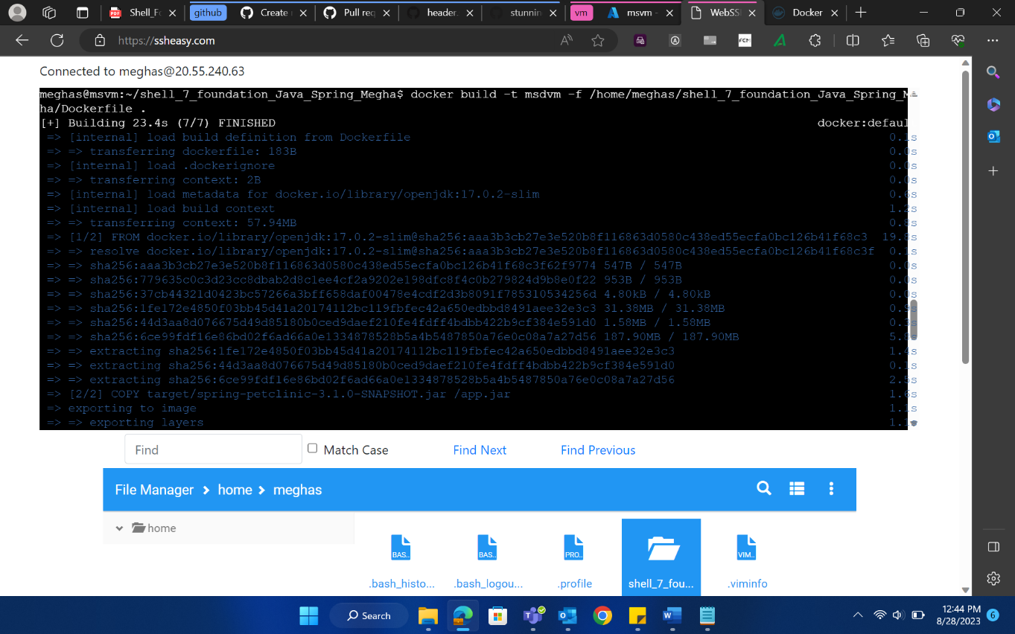
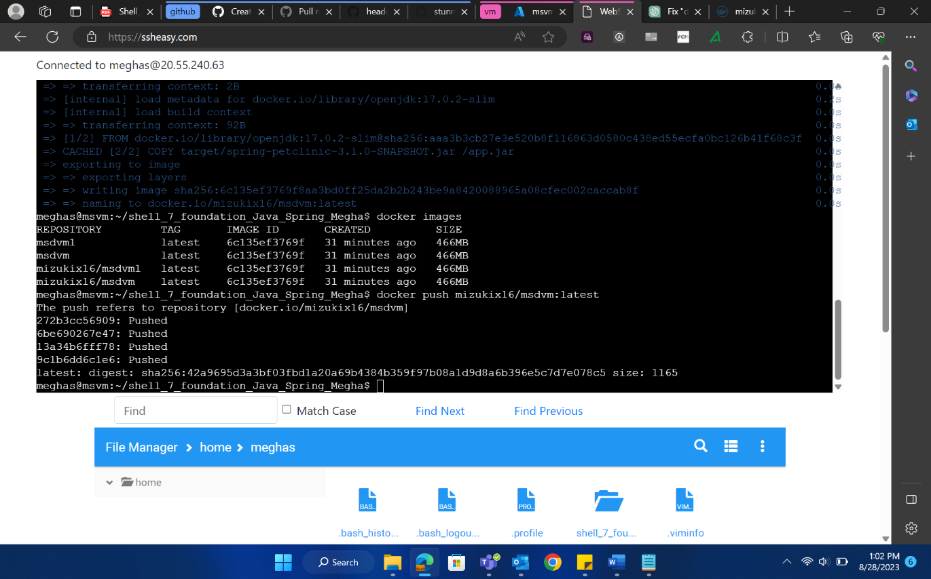
Case study continuation
6. Dockerfile Creation
Creating docker image
Pushing docker image

Slide 9
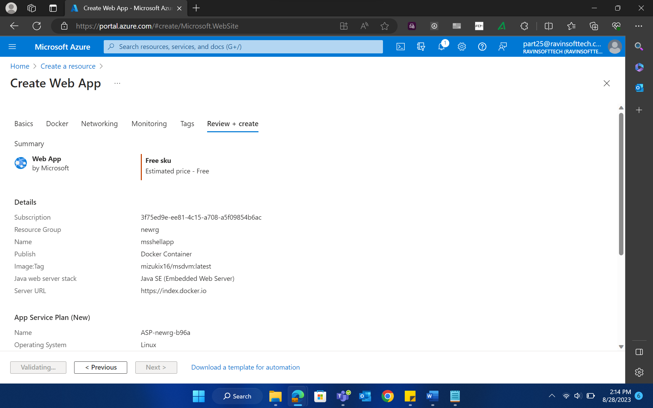
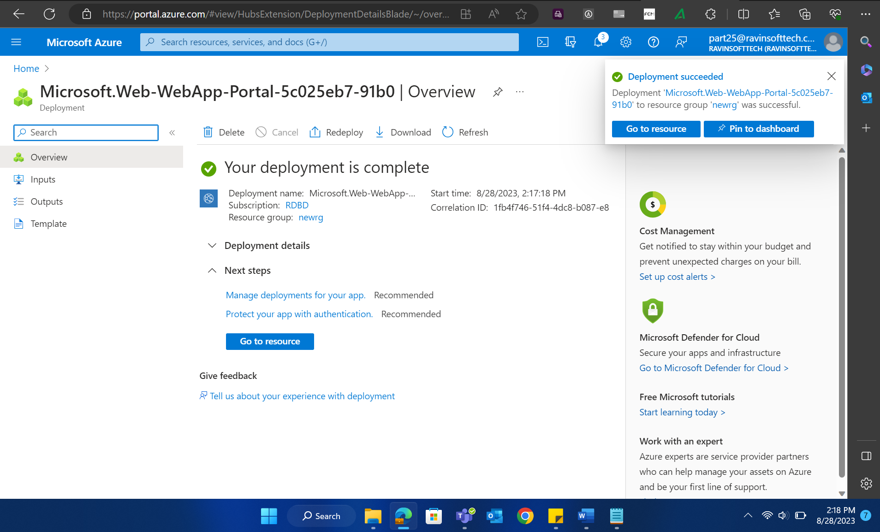
Case study continuation
7. Azure Web App Creation
8. Azure Web App Deployment

Slide 10
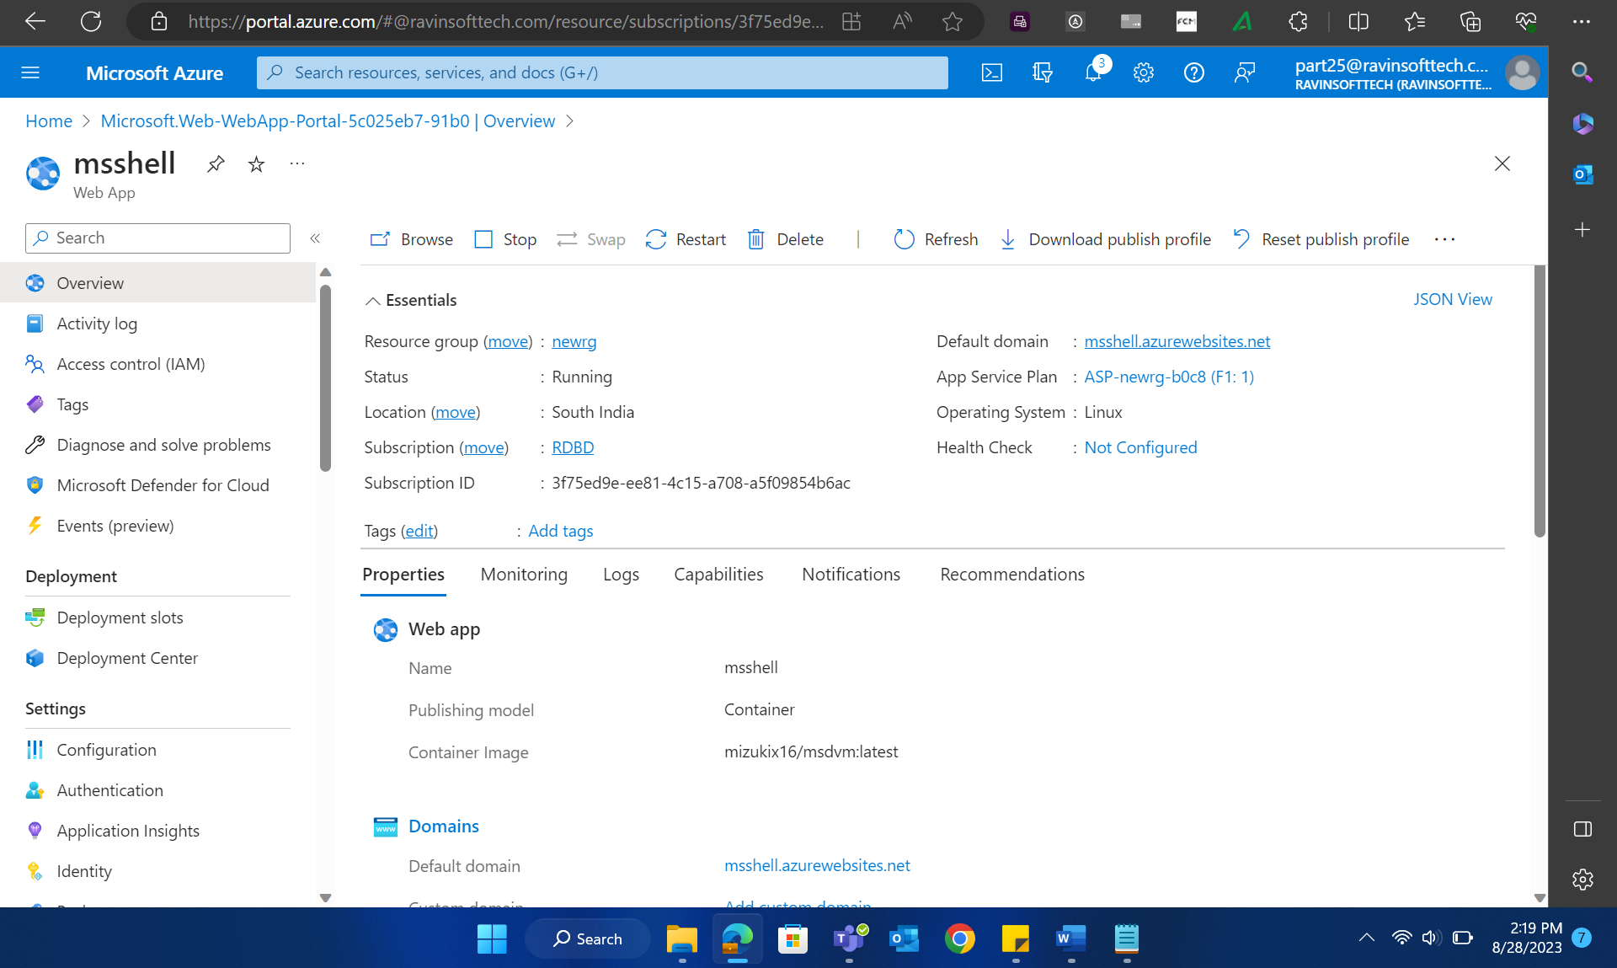
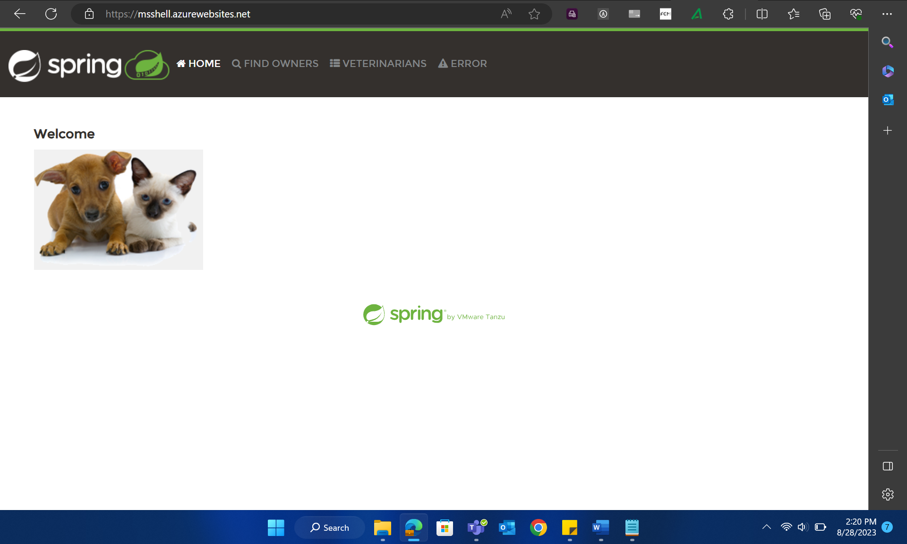
Case study continuation
9. Testing the Output

Slide 11
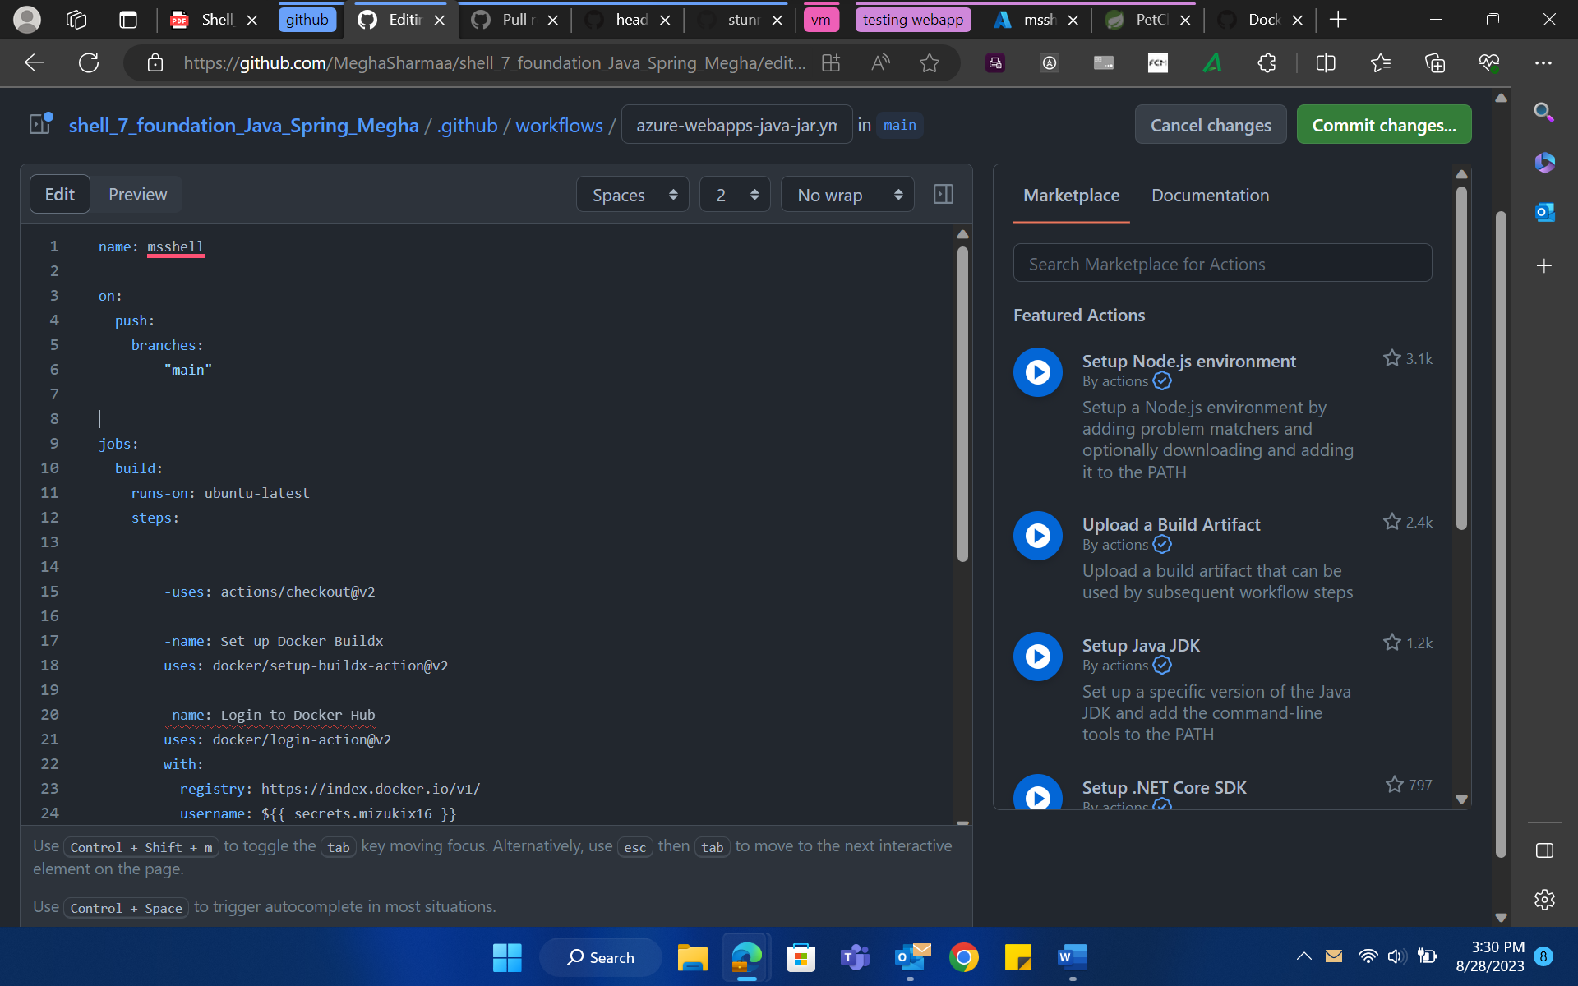
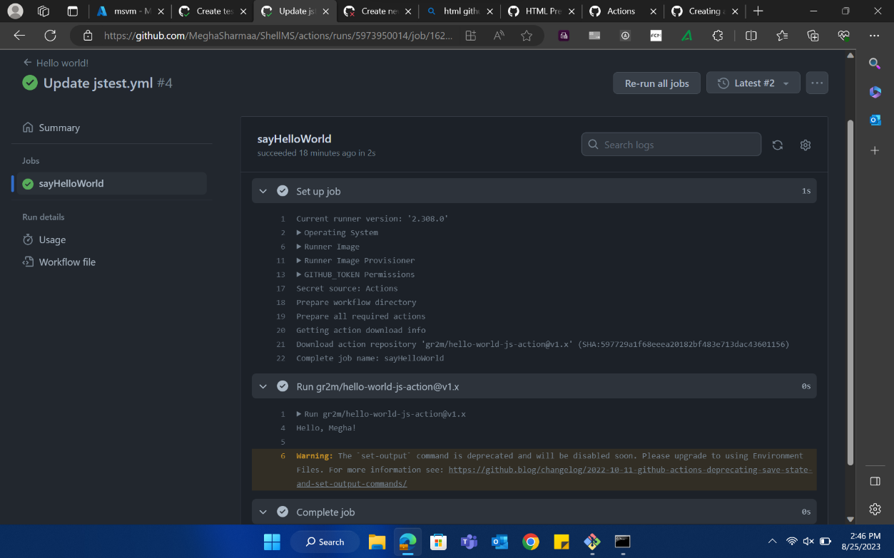
Case study continuation
10. Github Actions
Workflow yaml
Job running 1

Slide 12
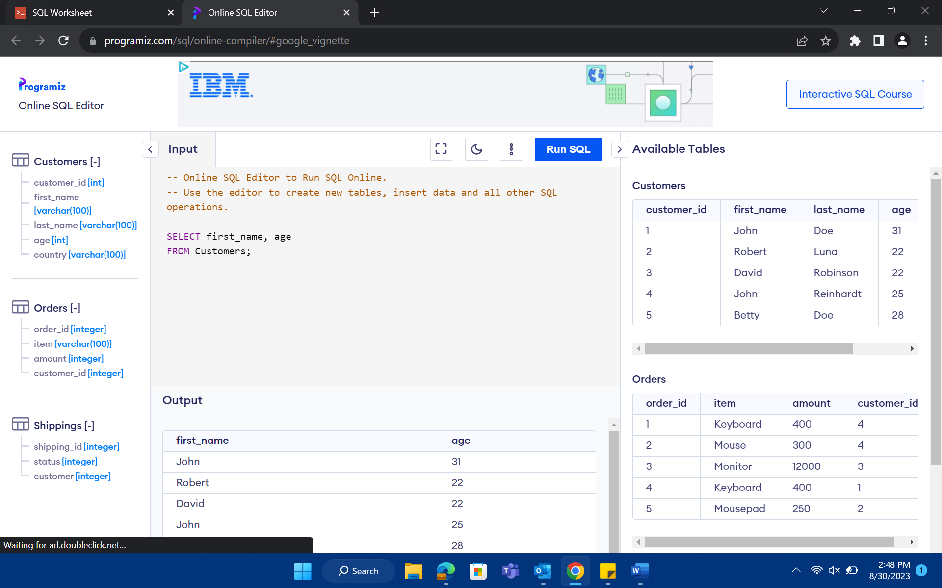
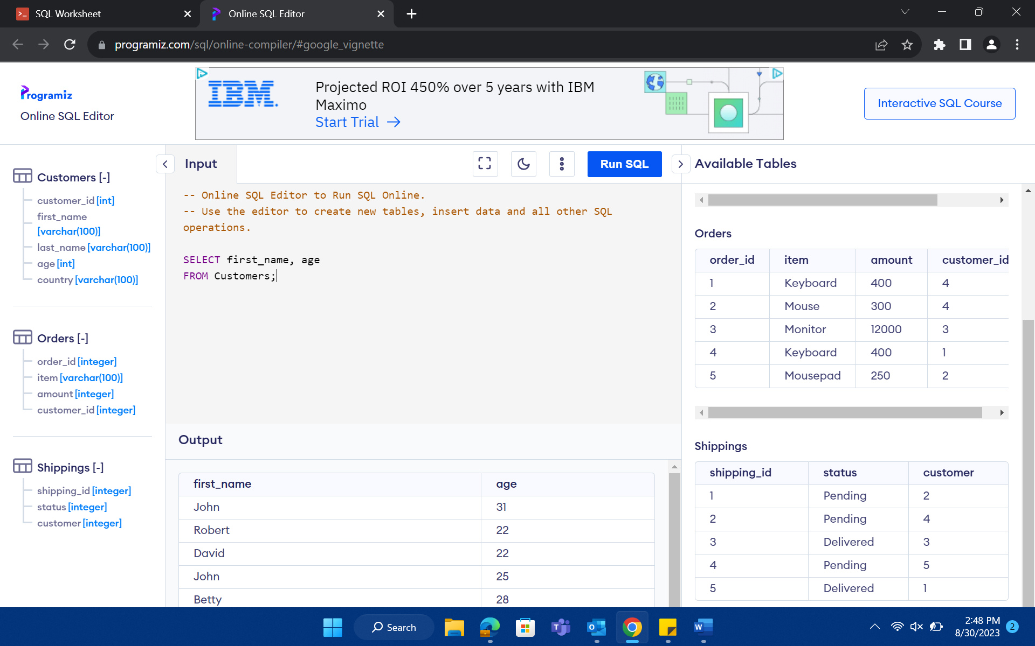
Day 2 (29/08/23)
Data warehousing
Difference between OLAP and OLTP
Difference between Data warehouse and Data mart
Data warehouse properties
Data cube: slicing, dicing

Slide 13
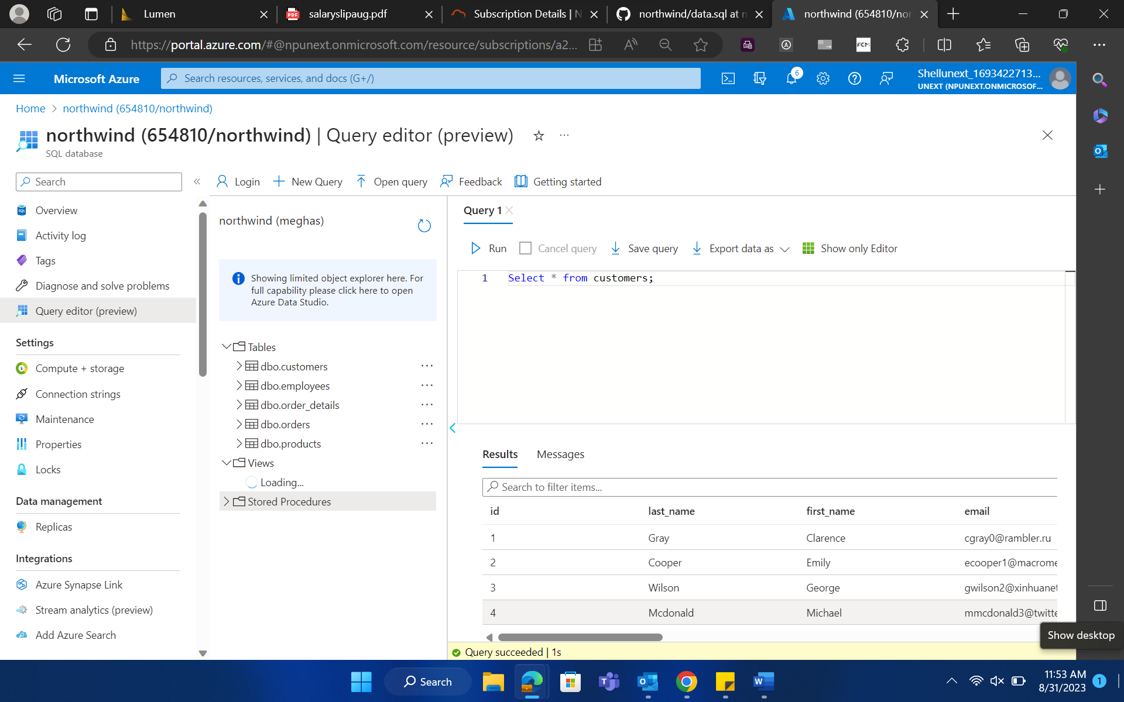
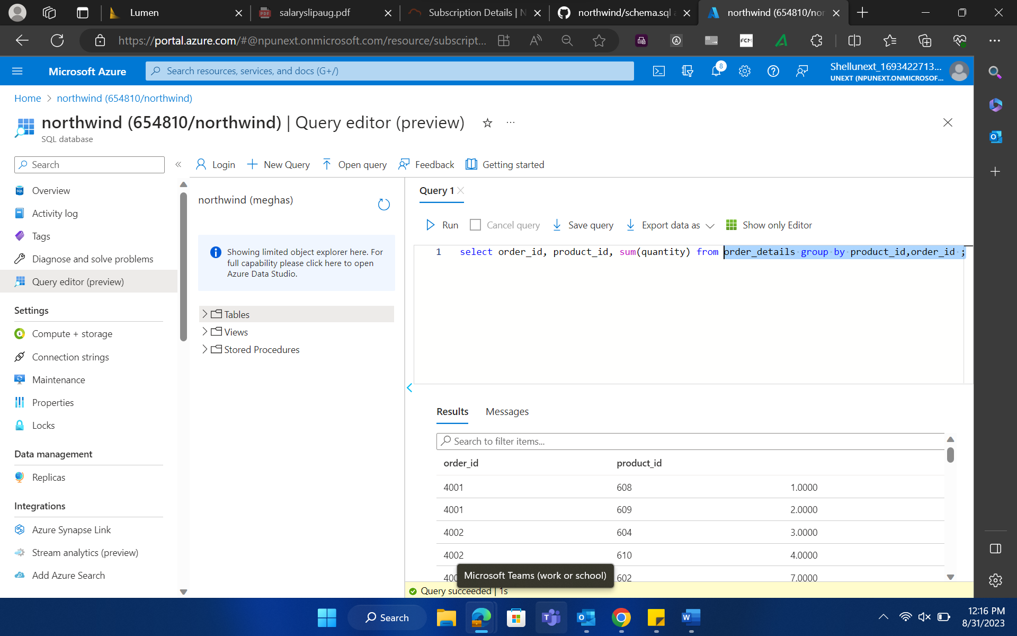
Day 3 (30/08/23)
No-SQL, unstructured database
Difference between Structured and Unstructured database
Intro to Hadoop
Data lakes

Slide 14
Day 4 (31/08/23)
Microsoft Azure SQL
Azure SQL editor
SQL queries
Group by
Joins

Slide 15
Day 5 (01/09/23)
Intro to Microsoft azure database and Query editor
Hands on approach to:
Joins
Aggregate functions
Group by clause
Having clause
Sub-queries

Slide 16
THANK YOU

